Slide 1
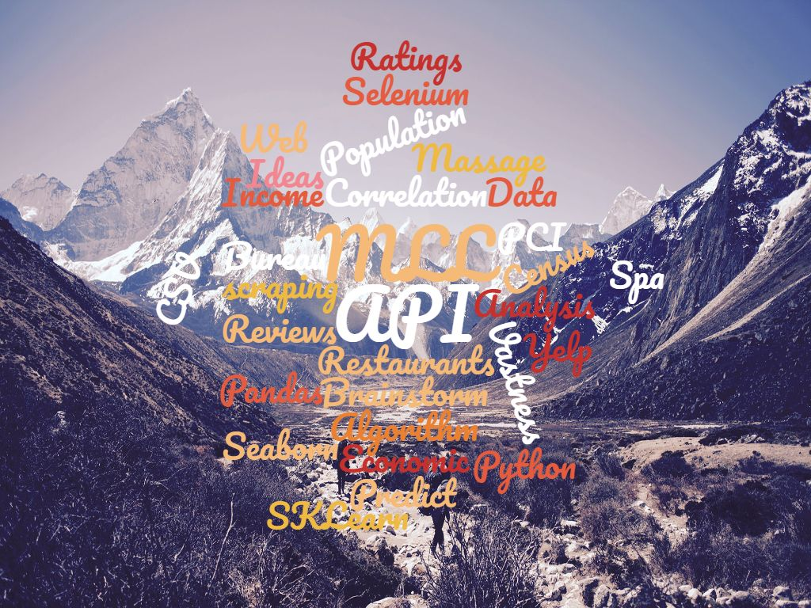
How to begin?
Notes:
The openness of these projects often leaves me feeling a bit uncertain of which direction to go. The vastness of data, can I find the data, quality of data, and will it lead to a dead end?

Slide 2

The questions
Can a prediction be made from this data? Ex., Is it a good idea to open a restaurant in Denver?
Is there a correlation between Per Capita Income(PCI) and some available business data from Yelp?

Slide 3

Faith is taking the first step even when you don’t see the whole staircase. - Martin Luther King Jr.
Collect Data
Web scraping
API Calls
Yelp – Business Data
Bureau of Economic Analysis(BEA) - PCI
Census Bureau CSV download – Population
Clean and Organize Data
Remove all unnecessary data
Reformat and parse data
Create consistency between all dataframes
Notes:
I’ve found from previous projects that the first ideas have been dead ends. Not knowing if I can get the data and where it will lead has a certain since of adventure. Hence the choice of pictures throughout this slide. I also wanted to use a ML king jr quote because I wanted to point out awareness of the effect of ML algorithms design on real people. My first steps were, the list. Talk on what was some unnecessary data(, (), ‘ ‘ , lower, capital cases, town, city, independent, county).

Slide 4


First Databases
Databases
Yelp Business
Spa – 59,000
Rest – 66,000
Population
- 81,500 Cities
PCI
- 3140 Cities
State Abbr.
Merge
St. Abbr -> Yelp & Pop
PCI -> Pop
Pop -> Yelp

Slide 5

Obstacles
API limitations
Web scraping and multi filters
Availability of data
Missing data
Unexpected Breaks

Slide 6
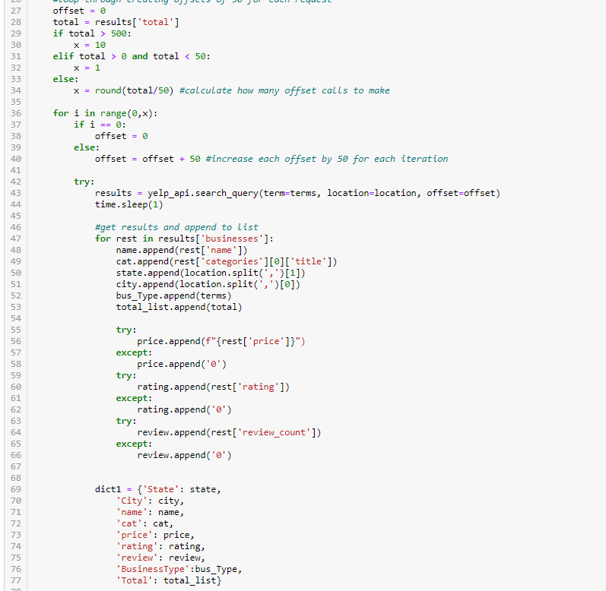

Overcoming Obstacles
API
Notes:
Time.sleep() – try & except, offset loop, append list of dictionary, start where left off from, handling missing data, don’t forget to turn off sleep ☺

Slide 7
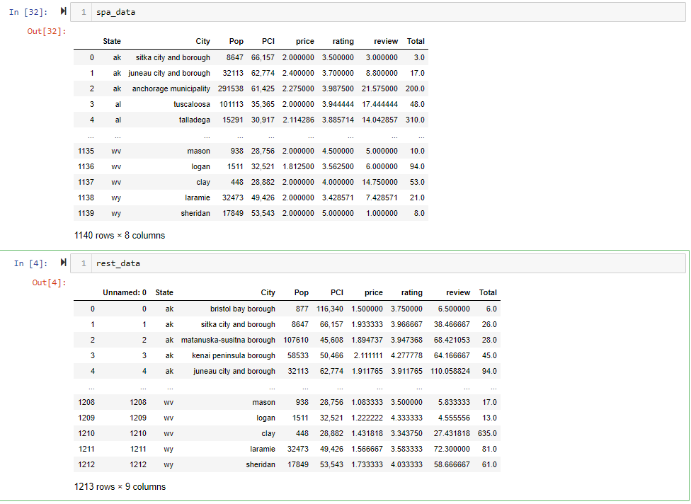
Create an aggregate database for ml models

Slide 8
Will there be any correlation?

Slide 9
The unspoken problem.

Slide 10
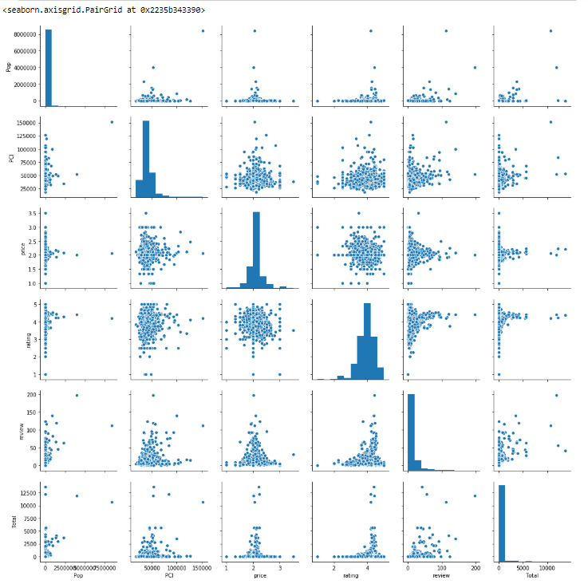
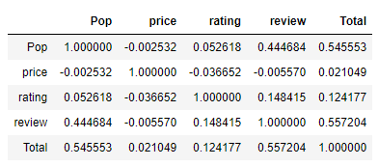


Slide 11
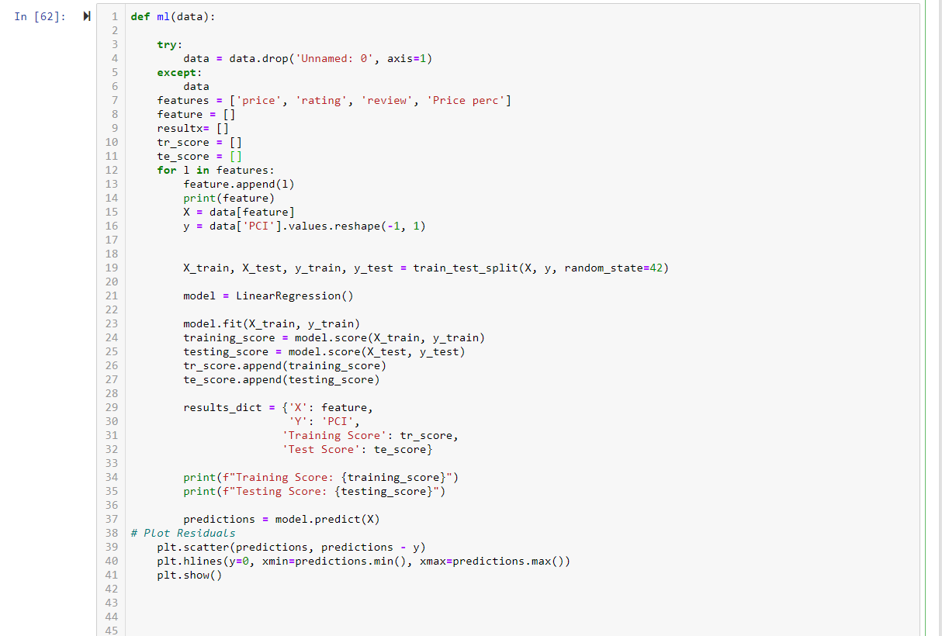

Deeper dive – new databases
API
Hotel Data
High priced for every Database
Low priced for every Database
High Population
Hotels Per Person vs Restaurants Per Person
Notes:
Time.sleep() – try & except, offset loop, append list of dictionary, start where left off from, handling missing data, don’t forget to turn off sleep ☺

Slide 12

Fellow classmates, Thank you!
You’re all awesome!
TA’s, Thank you!
You’re also super awesome!
And of course….
Svitlana, thank you so much!
You’re extra super awesome!

